Slide 1





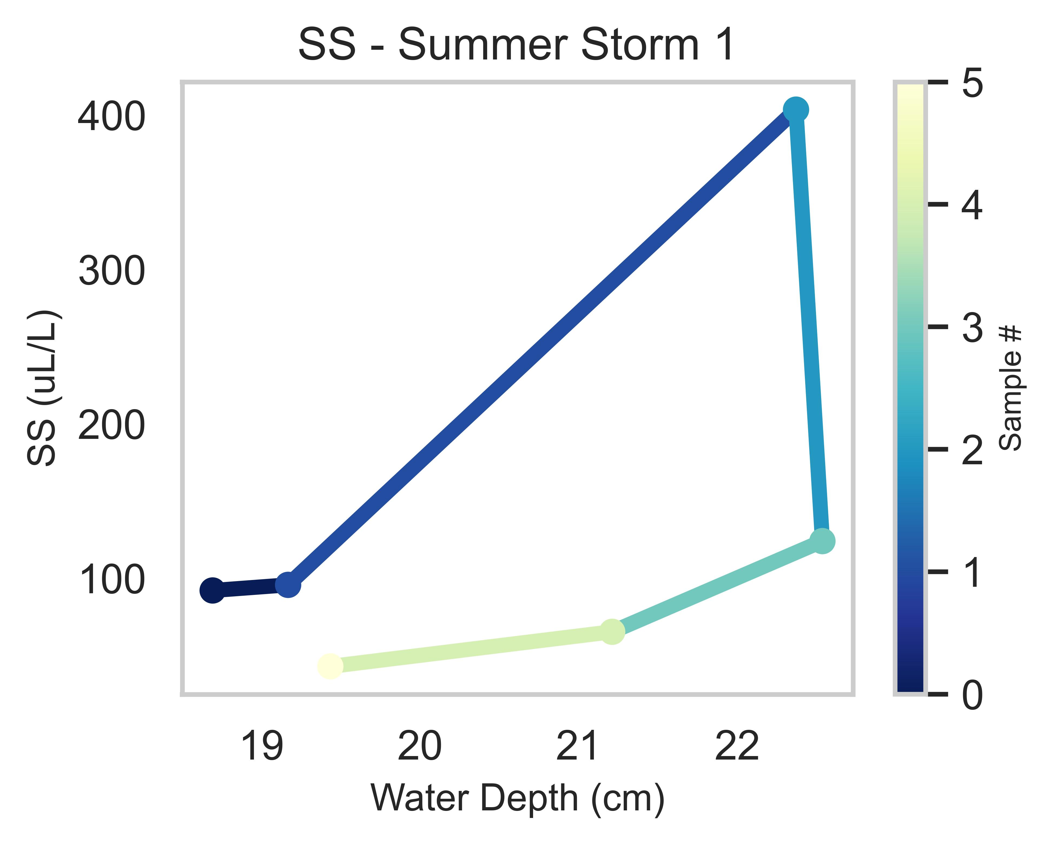
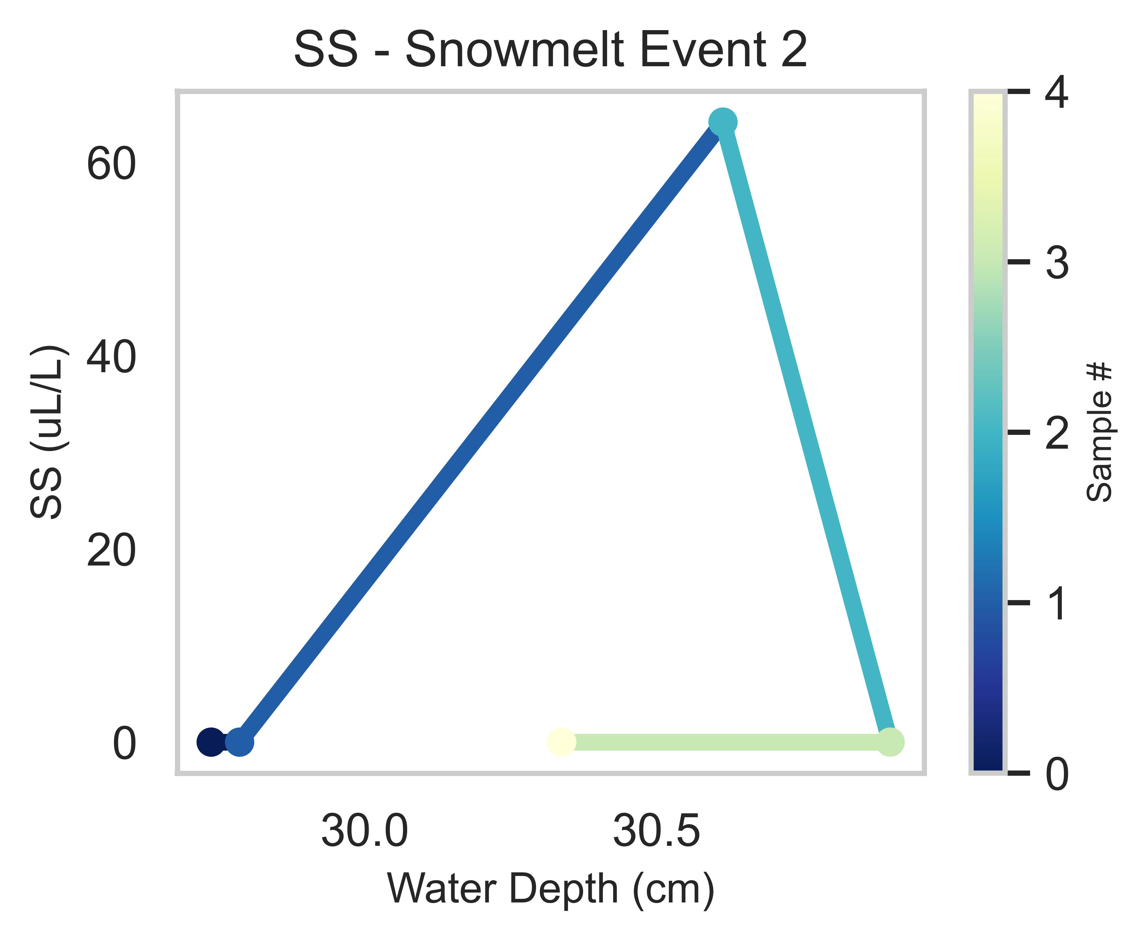
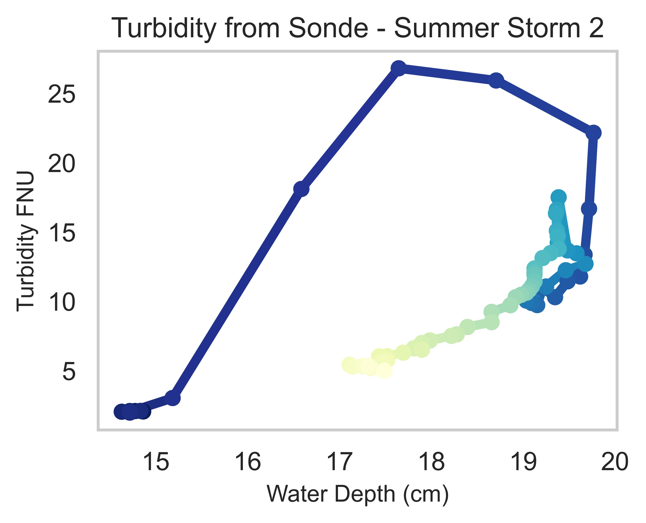
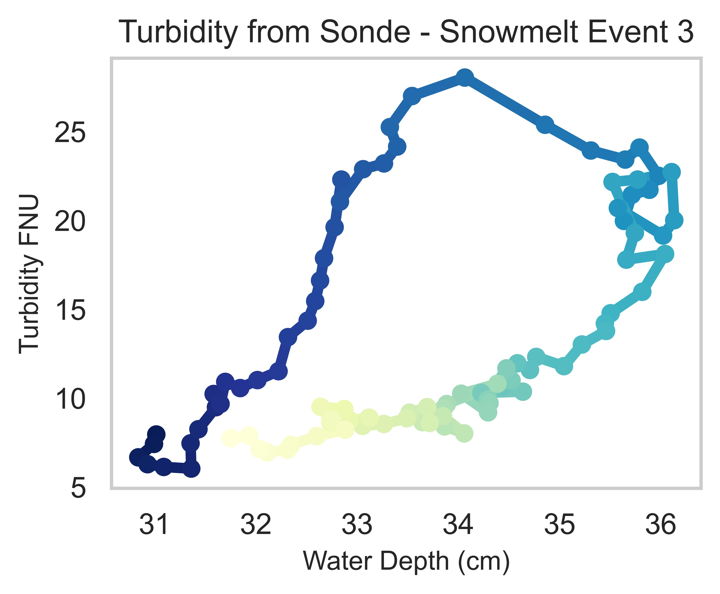
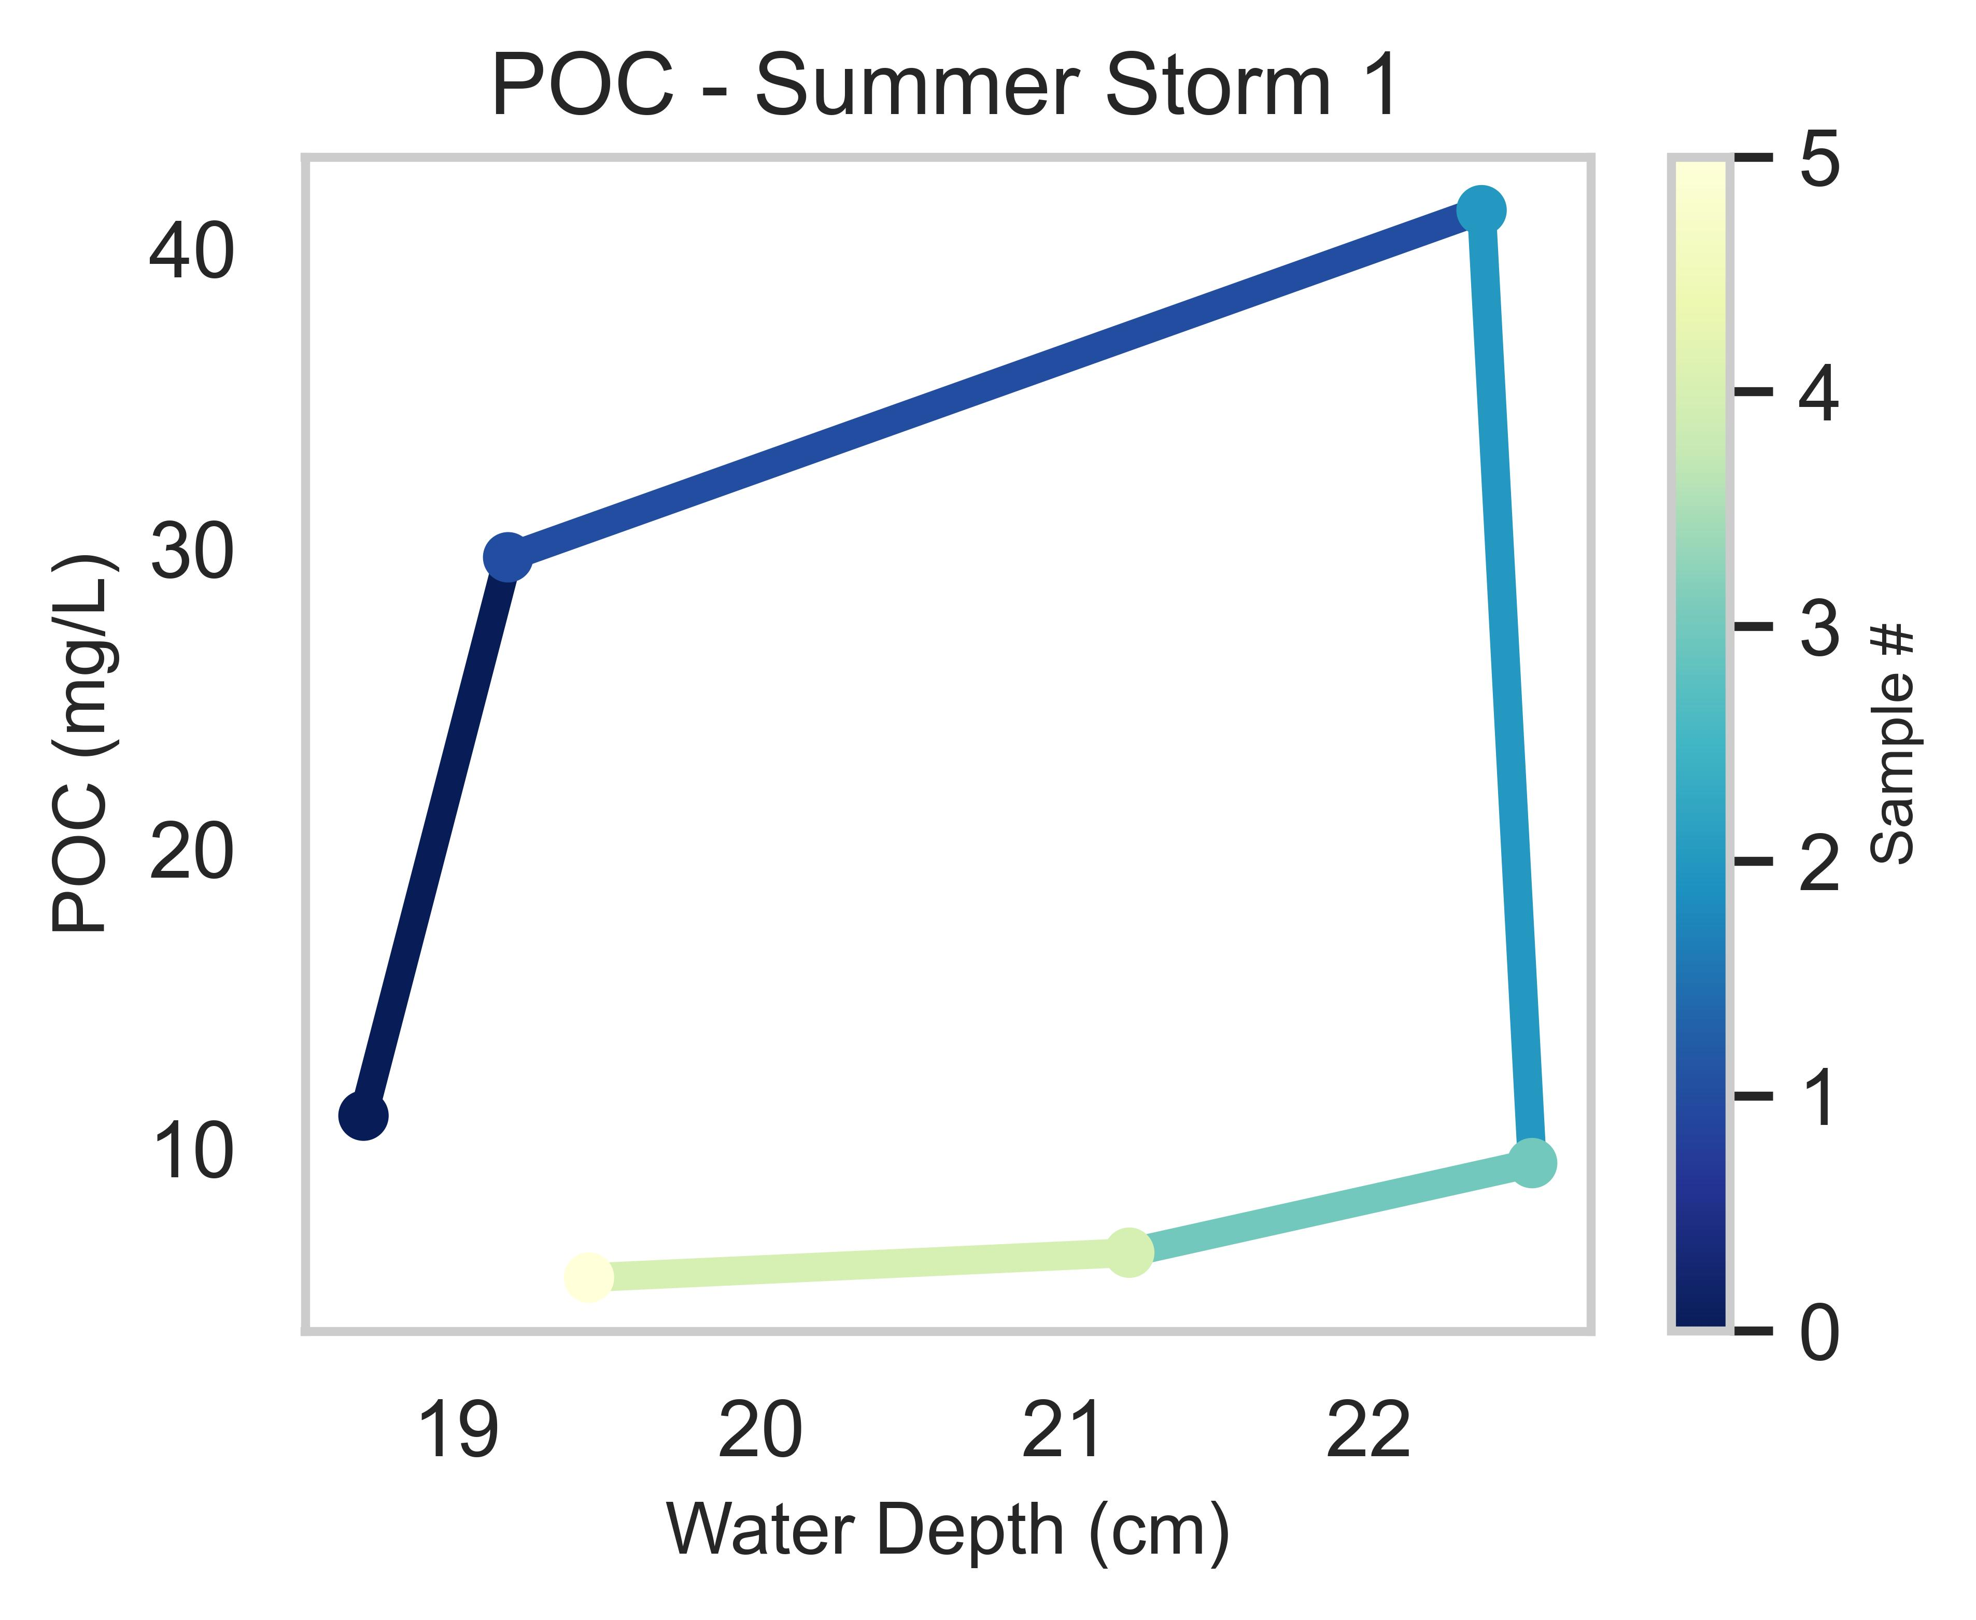
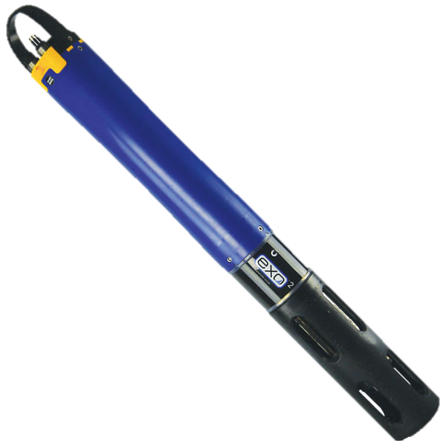
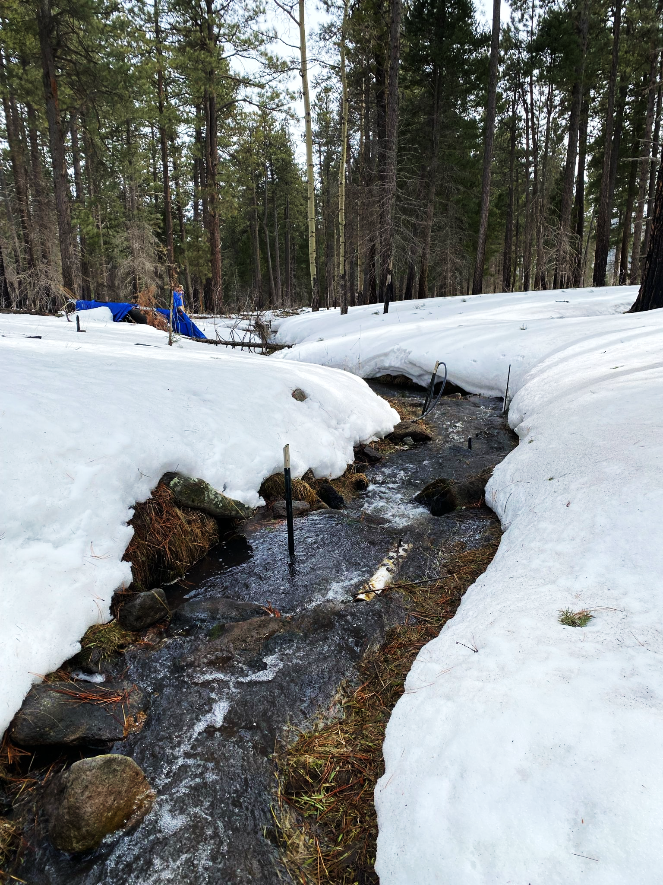
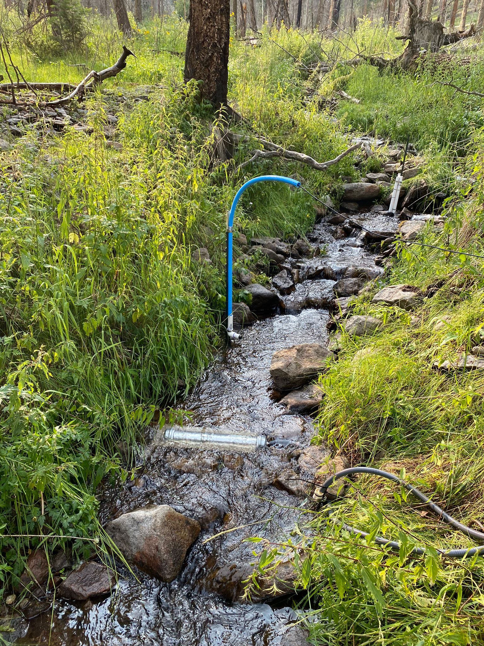
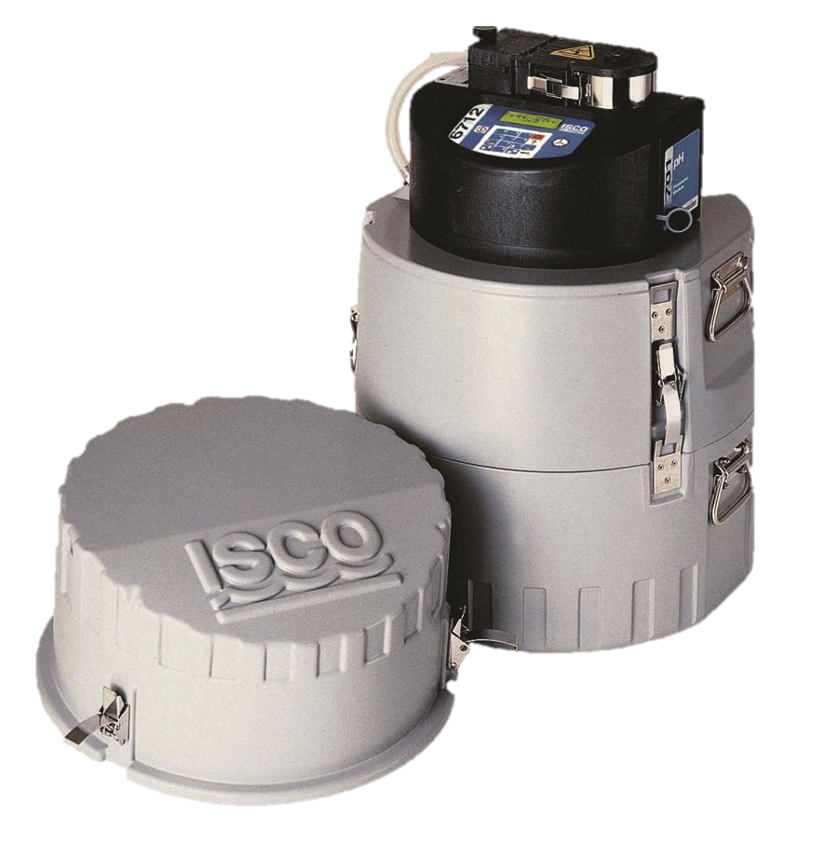
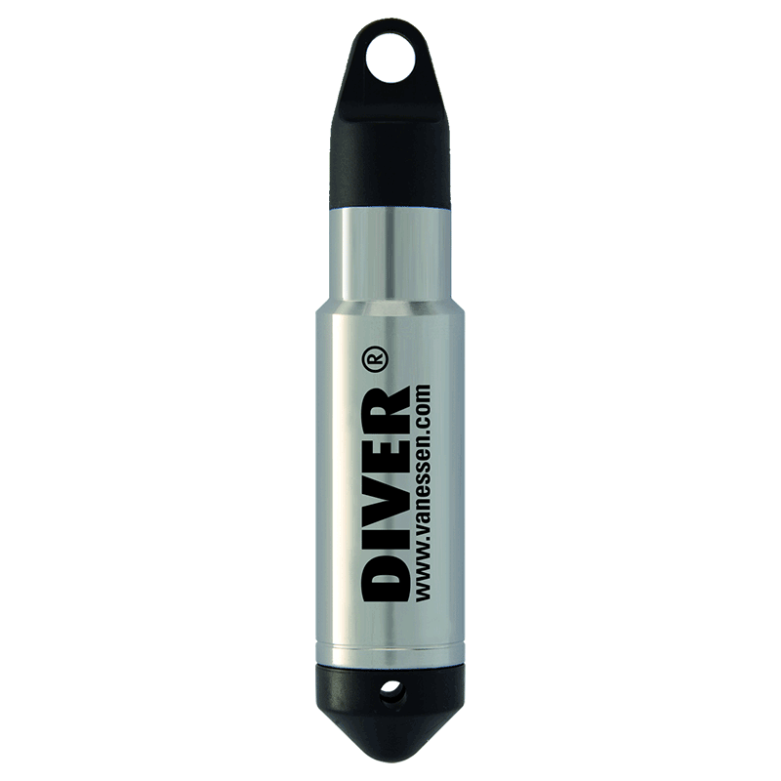
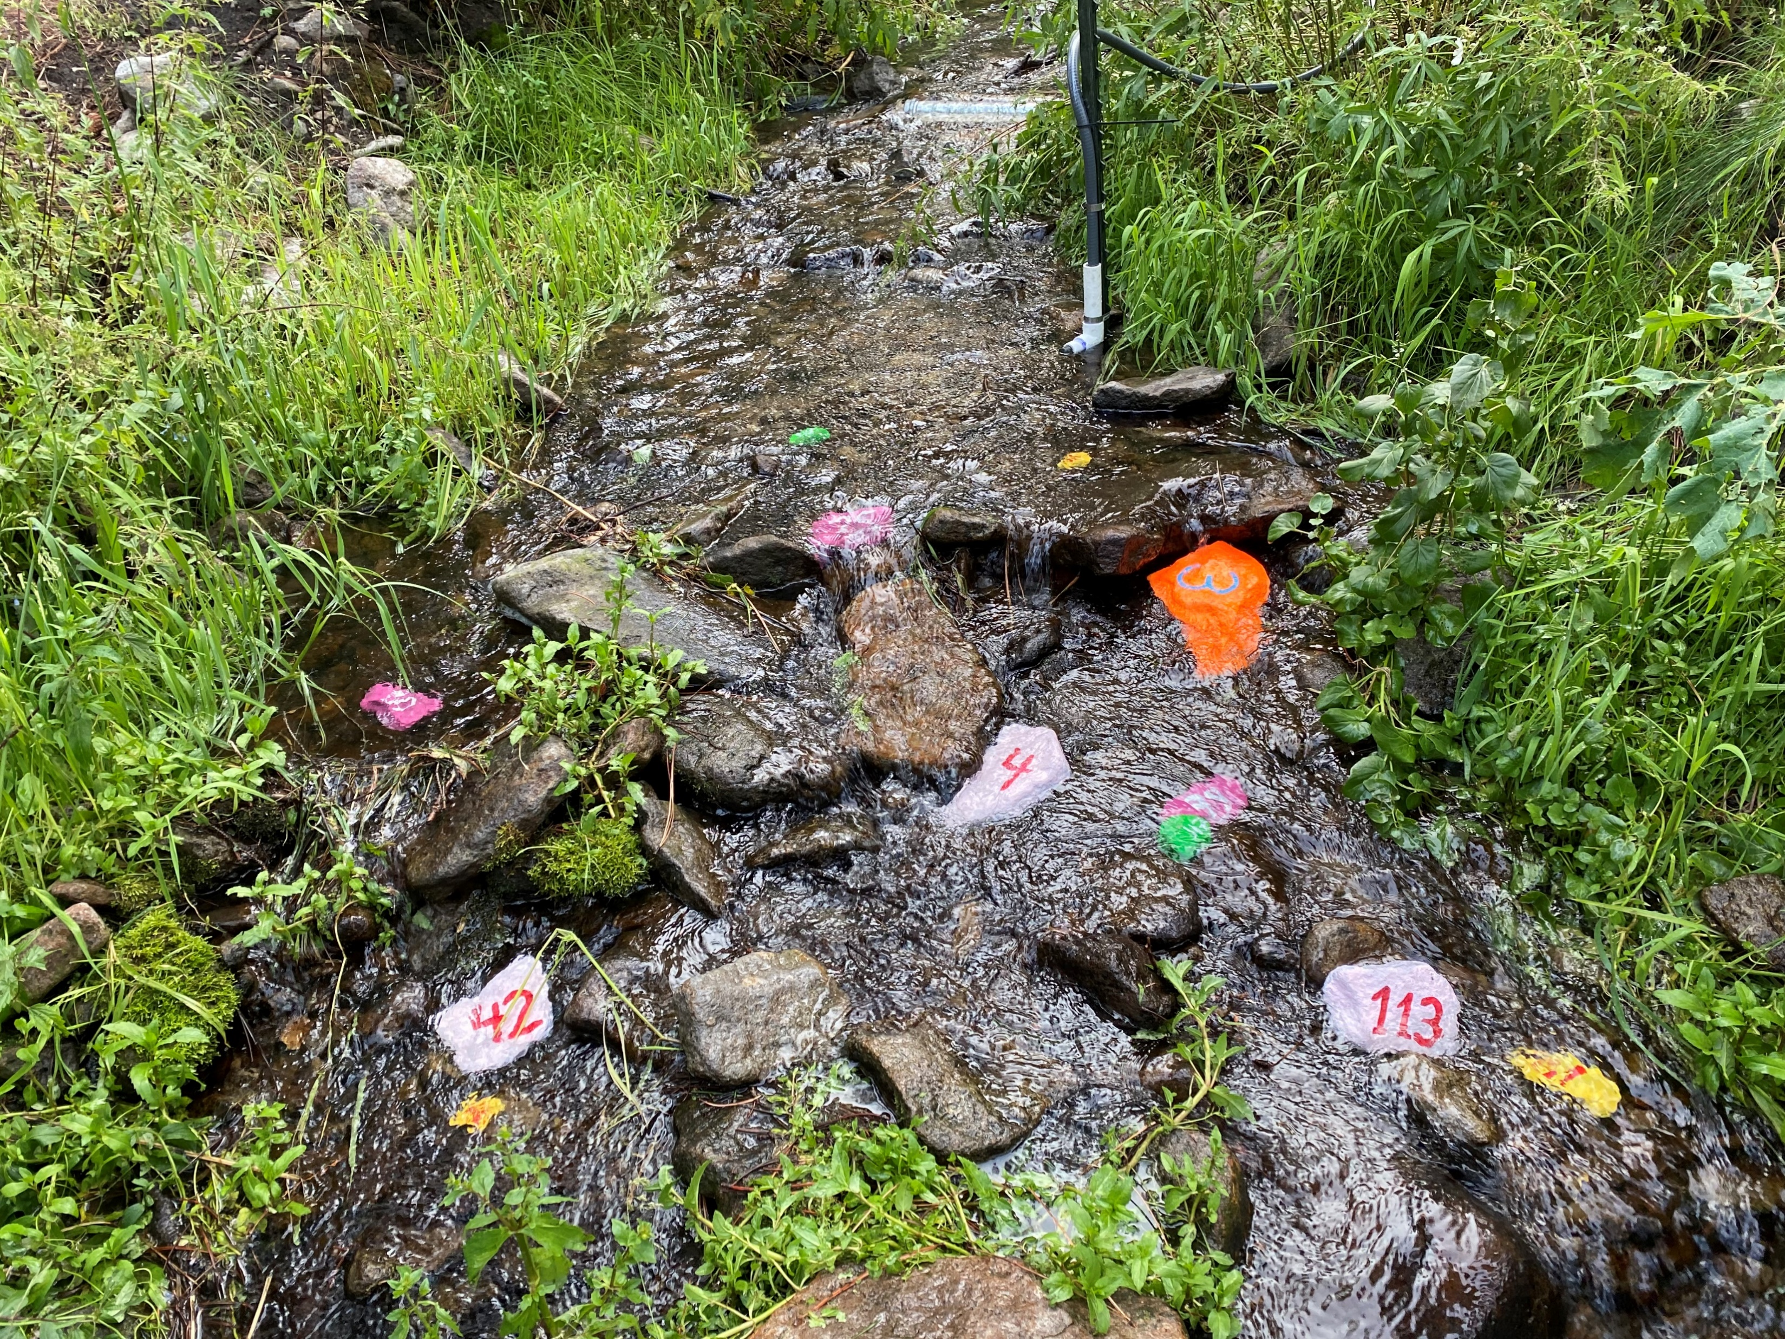
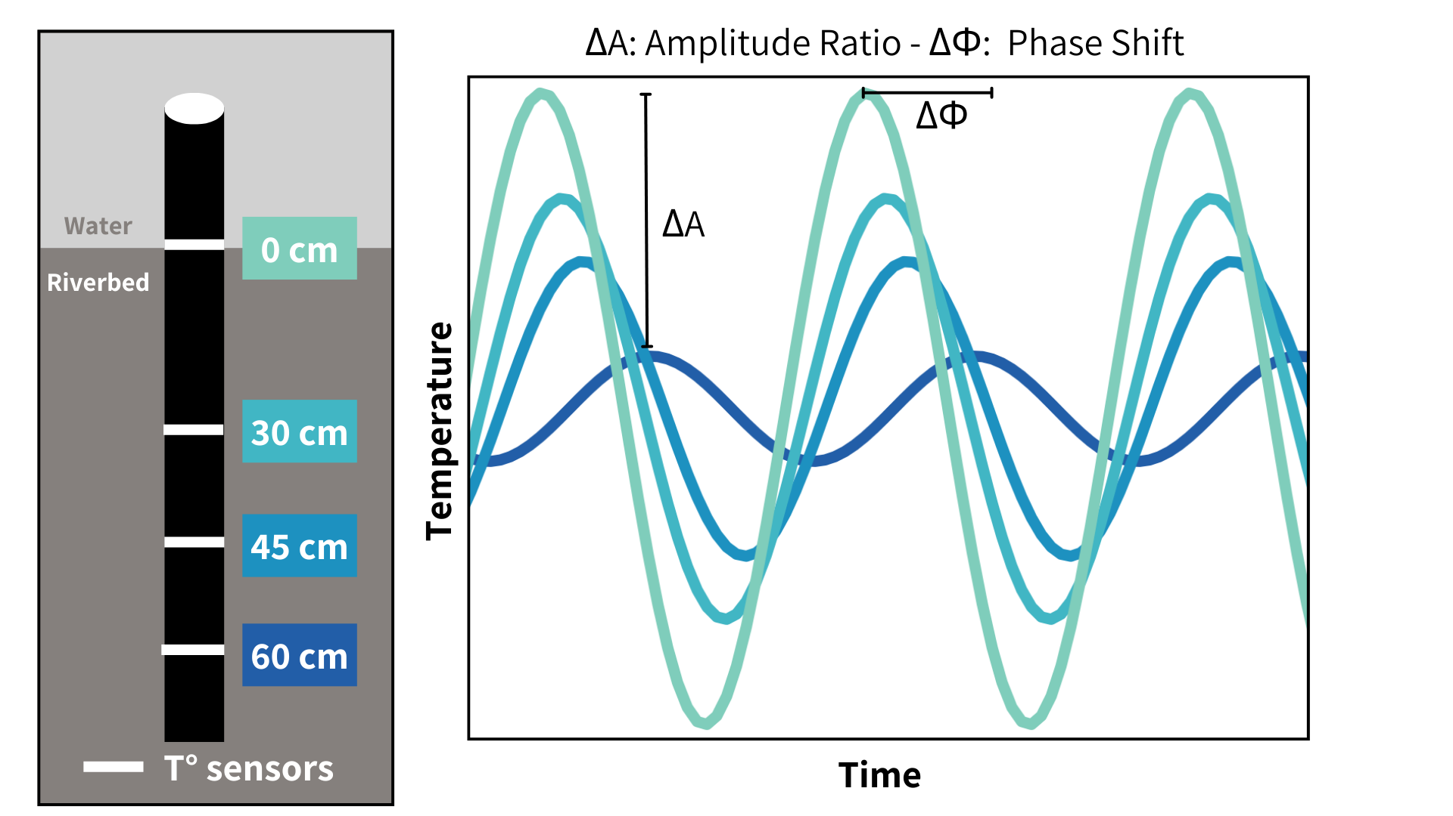
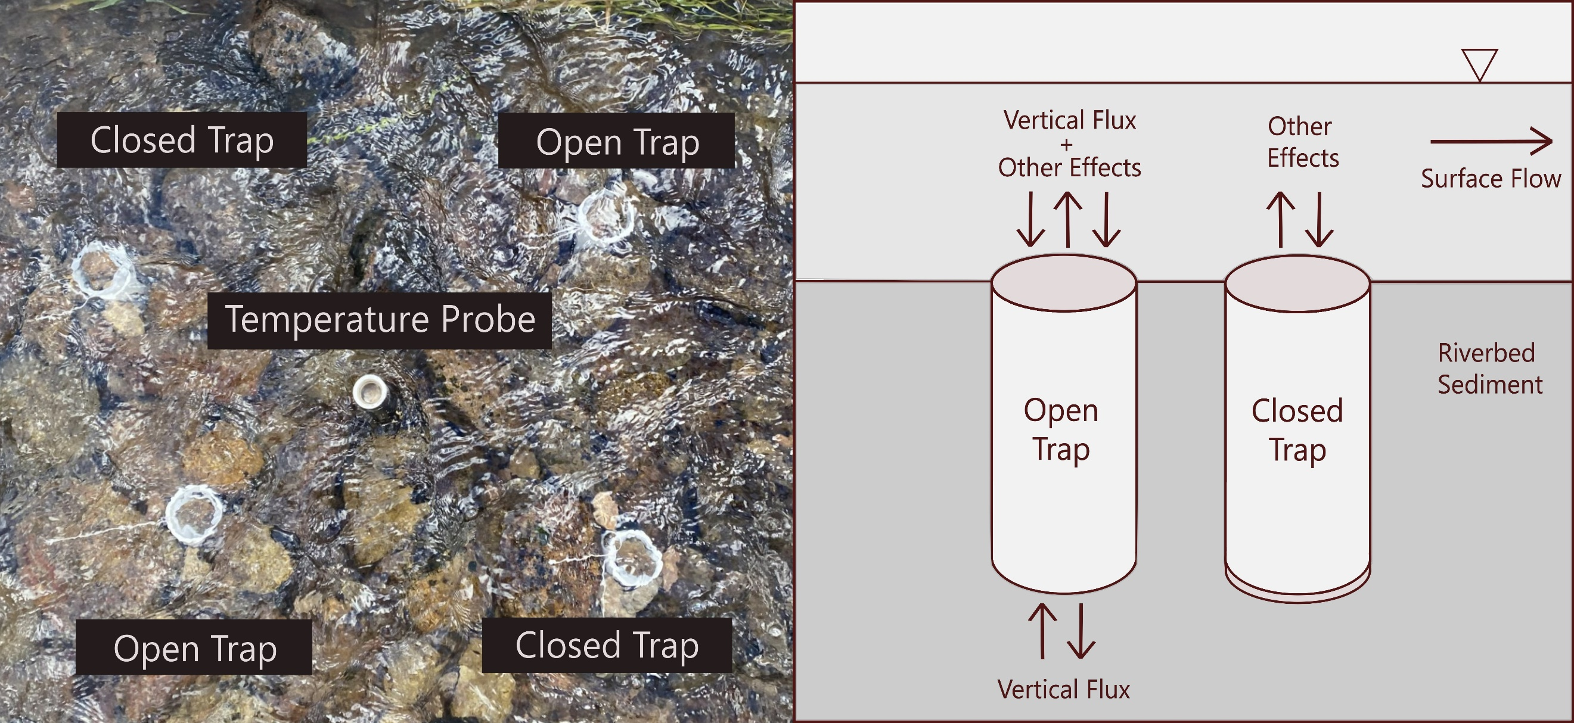
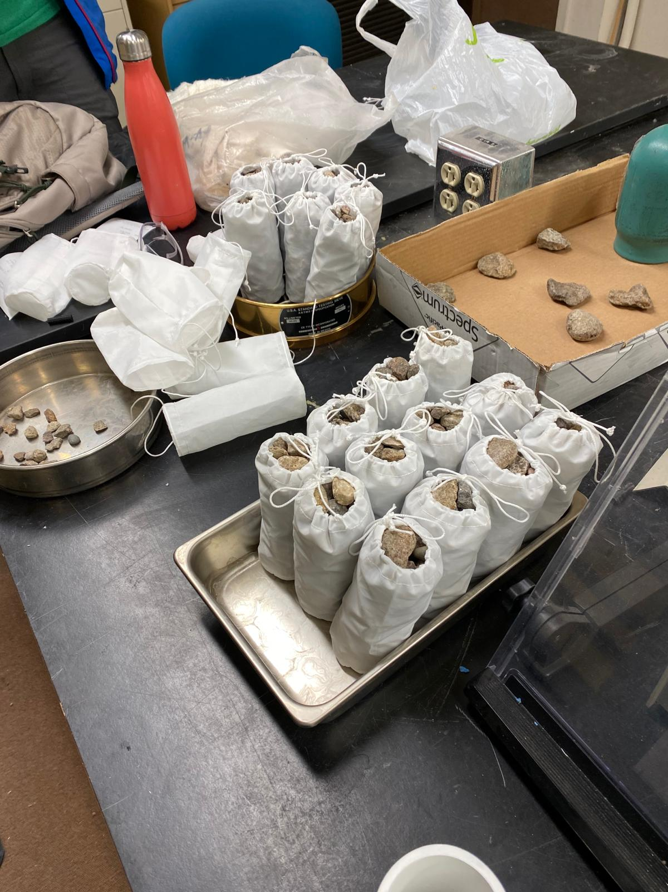
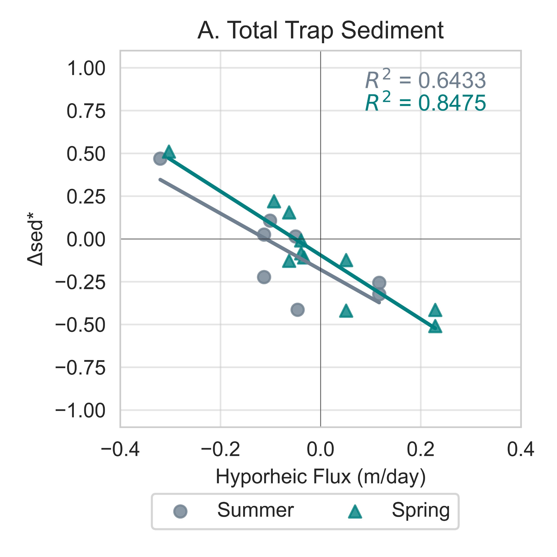
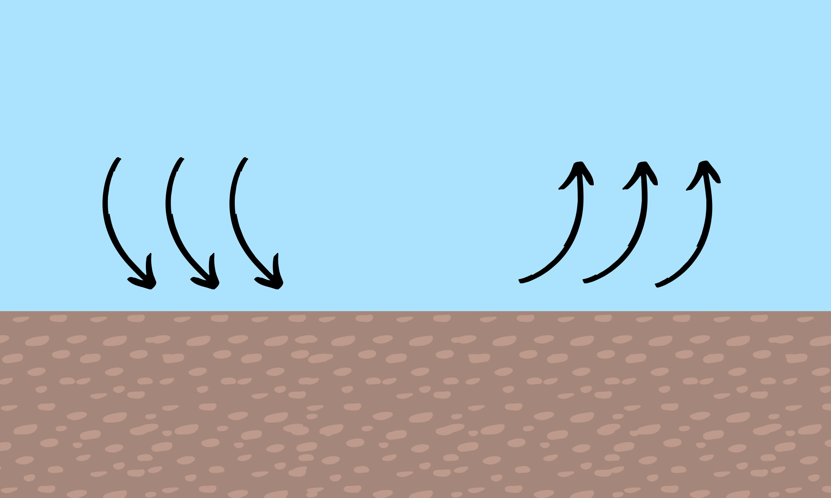

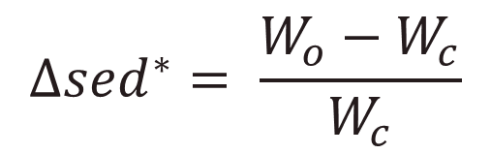
Hyporheic flux and antecedent flow conditions influence the retention and release of fine sediment and nutrients from streambeds
Elowyn Yager¹, Nicole Hucke^{1*}, Andrew Tranmer¹, Janice Brahney², Joel Rowland³, Rachel Watts², Sebastian Bernal¹, Abigail Toretsky², George Perkins³ and Rose Harris³
¹University of Idaho, Boise, ID
²Utah State University, Logan, UT
³Los Alamos National Laboratory, Los Alamos, NM
Environmental System Science Program
Introduction
Results
Seasonal Constituent Hysteresis
The armor layer protects the finer bed subsurface from erosion, but when dislodged during high flow events it can release fine sediment enriched in Phosphorus (P) and Organic Carbon (OC).
Hysteresis and seasonal variations in particulate and soluble reactive phosphorus (PP and SRP) and in Particulate Organic Carbon (POC) could be controlled by armor layer motion, which protects finer subsurface sediment from erosion.
A total of 7 summer and 4 snowmelt high flow events were captured for hysteresis
A
B
C
D
Q
and
[C]
Q
and
[C]
Fine sediment deposition
Low Flow
Large Flow
Time
Time
Q
and
[C]
or
Q
and
[C]
Fines are protected by armor
Armor begins to move
Fines are released in water
Time
Time
The released concentrations of suspended sediment (SS), PP, SRP and POC will depend on the subsurface sediment composition which may partly vary with local hyporheic flux, as it brings water column SS into and out of the streambed.
Spring POC concentrations were too low that no reliable hysteresis could be obtained
Methods
Study Site: La Jara Creek,
Valles Caldera National Preserve, NM
1. Capturing Hysteresis:
Turbidity
Collected using a YSI EXO2 Sonde
Particulate constituents (SS, POC and PP) exhibited clockwise hysteresis in the summer. SS behaved similarly in the spring
Water samples (SS, SRP, PP and POC)
Stage-triggered portable ISCO samplers
Dissolved constituents (DOC and SRP) differed in their behavior. Hysteresis for SRP changed for different summer storms. This suggests that these constituents might come from different sources
Flow depth and Discharge
Pressure transducers in stilling wells
Channel slope: 8-10% and width: 1 m
* Fluorescent dissolved organic matter – a reliable proxy for DOC
2. Armor layer movement:
Laboratory Procedures
RFID tracer particles and Hydrophones
SS – Laser diffraction
method (LISST portable XR)
POC – Eurovector elemental analyzer coupled to an Isoprime IRMS
SRP & PP – SpectraMax M2e
Particle sizes & distances
Particle sizes & timing
Tracer particle locations were recorded before and after each high flow event and transported distances were computed through the triangulation method
Hydrophone acoustic signals determine when armor layer moves
3. Hyporheic-induced sediment deposition:
Sediment traps with open and closed bottoms were installed next to hyporheic flux probes during the spring and summer of 2023.
Hyporheic…
iFLOW (Bertagnoli, et al., 2024) to calculate advective flux using temperature record of the probes
Results
Hyporheic-Driven Fine Sediment Deposition
Percent Difference:
Wo > Wc
Total Trapped Sediment .
$$∆{sed}^{∗}= \frac{W_{o}−W_{c}}{W_{c}}$$
- Downwelling:
more sediment in open traps
Wo < Wc
- Neutral fluxes:
similar amounts
- Upwelling:
more sediment in closed traps
Vertical hyporheic flux can change sediment deposition by ±50%
Downwelling
Upwelling
Longer suspended sediment duration in spring allows for more hyporheic influence on deposition
Hyporheic flux may be able to influence deposition of sand moving as bedload
For questions, please contact huck4481@vandals.uidaho.edu or eyager@uidaho.edu

